Slide 1



Department of Computer Science and Engineering
          ADAPTIVE TRAFFIC CONTROL SYSTEM USING NEXT-GEN AI
          ARUNKUMAR J 211420104026
          BHARATHWAJ M 211420104039
Sustainable Development Goals:
G 3 - Good Health and Well-being
G 9 - Industry, Innovation, and Infrastructure
G 11 - Sustainable Cities and Communities
G 13 - Climate Action
GUIDE:
Dr. N PUGHAZENDI M.E., Ph.D.,
Professor

Slide 2
Introduction
In today's bustling urban landscapes, traffic congestion presents a persistent and formidable challenge, necessitating innovative solutions to alleviate gridlock effectively. This paper introduces a pioneering approach that capitalizes on the integration of surveillance cameras and cutting-edge
Machine Learning (ML) and Deep Learning (DL) techniques for the autonomous monitoring and regulation of traffic signals.
Through such proactive measures, substantial reductions in traffic congestion are anticipated, paving the way for smoother and more streamlined urban mobility in the years ahead.
By leveraging the capabilities of surveillance cameras and advanced ML and DL algorithms, this research endeavors to address the multifaceted challenges posed by modern traffic congestion

Slide 3
Objective of the Project
This system aims to regulate the traffic congestion dynamically i.e. based on traffic density and traffic flow rate. It aims to improve traffic flow and reduce congestion on busy roads.
This system computes length of time that a traffic signal should remain green based on the value of traffic density in the lane.
It is computed by detecting and counting the number of vehicles by the image processing and object detection algorithms such as neural network architecture (YOLOv5) on the feeds from the camera of real-time traffic data.
Based on the density values, system also make decisions about lane closures and traffic rerouting. The main objective of the project is to provide a safer and more efficient travel experience for drivers on the road.

Slide 4
Literature Survey
YEAR | TITLE AND JOURNAL | AUTHOR | DESCRIPTION | ADVANTAGES | DISADVANTAGES
2022 | “IOT based Smart solution for Traffic congestion at Metro Cities” in International Conference on Innovative Computing, Intelligent Communication and Smart Electrical Systems | T. V. Janardhana Rao, R. Arun Sekar, B. Drakshyani, P Kalyan Chakravarthi, N. Kumareshan and S. P. Karthi | It suggests a paradigm to increase mobility by using roadside messaging devices. It is an IoT-based system that gather, analyse and store traffic data in real-time. This system was developed using machine learning algorithms such as neural networks and decision trees to process the data. | It highlights the potential use of technologies to revolutionize and improve the quality of life of residents in urban.

Slide 5
Literature Survey
YEAR | TITLE AND JOURNAL | AUTHOR | DESCRIPTION | ADVANTAGES | DISADVANTAGES
2021 | “Real-time traffic monitoring and traffic offense detection using YOLOv4 and OpenCV DNN” in IEEE Region 10 Conference (TENCON). | Fahimul Hoque Shubho, Fahim Iftekhar, Ekhfa Hossain and Shahnewaz Siddique | It uses some methodology for identifying the citizen who are making a traffic offence using computer based vision of YOLOv4 and OpenCV. The contemplated project there is a variation in the predicted traffic intensity then a real-time average is taken at that moment and is updated into the database and then is pushed to be learnt by the model | The complete methodology of the system is built using YOLOv5 to segregate and identify the types of vehicles and DEEP LEARNING for ideal flawless recognition of the traffic density

Slide 6
Literature Survey
YEAR | TITLE AND JOURNAL | AUTHOR | DESCRIPTION | ADVANTAGES | DISADVANTAGES
2020 | 2nd International Conference on Advances in Computing, Communication Control and Networking (ICACCCN) | Dr. Vikram Bali, Ms. Sonali Mathur, Dr. Vishnu Sharma and Dev Gaur | It is a IoT enabled technology by creating “Green Corridors” for emergency vehicles such as ambulances, fire-cars and also other vehicles. It is a smart and intelligent system to manage the traffic. It detects emergency vehicles by scanning the RFID tag applied on these vehicles using RFID reader. It helps vehicles to reach their destination in time. | It provides a valuable overview of the current state of the art in intelligent traffic management systems and offers insights into the potential for future advancements in the field

Slide 7
Literature Survey
YEAR | TITLE AND JOURNAL | AUTHOR | DESCRIPTION | ADVANTAGES | DISADVANTAGES
2018 | Smart Traffic Management System with Real Time Analysis | Sheena Mariam Jacob, Shobha Rekh, Manoj G and J John Paul | It is a system for solving traffic congestion which uses the ideology of them are to divide the traffic into 3 main parts like high medium and low. These are classified with the RASPBERRY AI using ultrasonic sensors and cameras | It provides a better solution to avoid the traffic congestion by detecting the variations of traffic densities. | The hardware used for the implementation of the hardware components are high which make the system inefficient.

Slide 8
Existing System
The traffic system that exists changes the signal light for the fixed time irrespective traffic density..
The traffic system needs a human assistance to regulate heavy traffic in metropolitan cities that too in peak hours.
The system fails to regulate the traffic as like traffic police do but then change the signal light.
This results in conjested traffic in metropolitan cities which make the people to wait for long time in roads.

Slide 9
Problem Statement
The problem in the existing system is that it do not regulate the traffic.
A traffic police is needed to regulate the traffic which makes the system inefficient.
So, a automated system is required to regulate the traffic considering the variations in the traffic density in the roads.

Slide 10
Proposed System
This system aims to regulate the traffic congestion dynamically i.e. based on traffic density and traffic flow rate.
It aims to improve traffic flow and reduce congestion on busy roads. This system computes length of time that a traffic signal should remain green based on the value of traffic density in the lane.
It is computed by detecting and counting the number of vehicles by the image processing and object detection algorithms such as neural network architecture (YOLOv5) on the feeds from the camera of real-time traffic data.
Based on the density values, system also make decisions about lane closures and traffic rerouting.
The main objective of the project is to provide a safer and more efficient travel experience for drivers on the road

Slide 11
Module
• Vehicle Detection
• Data preprocessing
• Model Development and Evaluation
• Density Calculation
• Estimating Signal Time

Slide 12
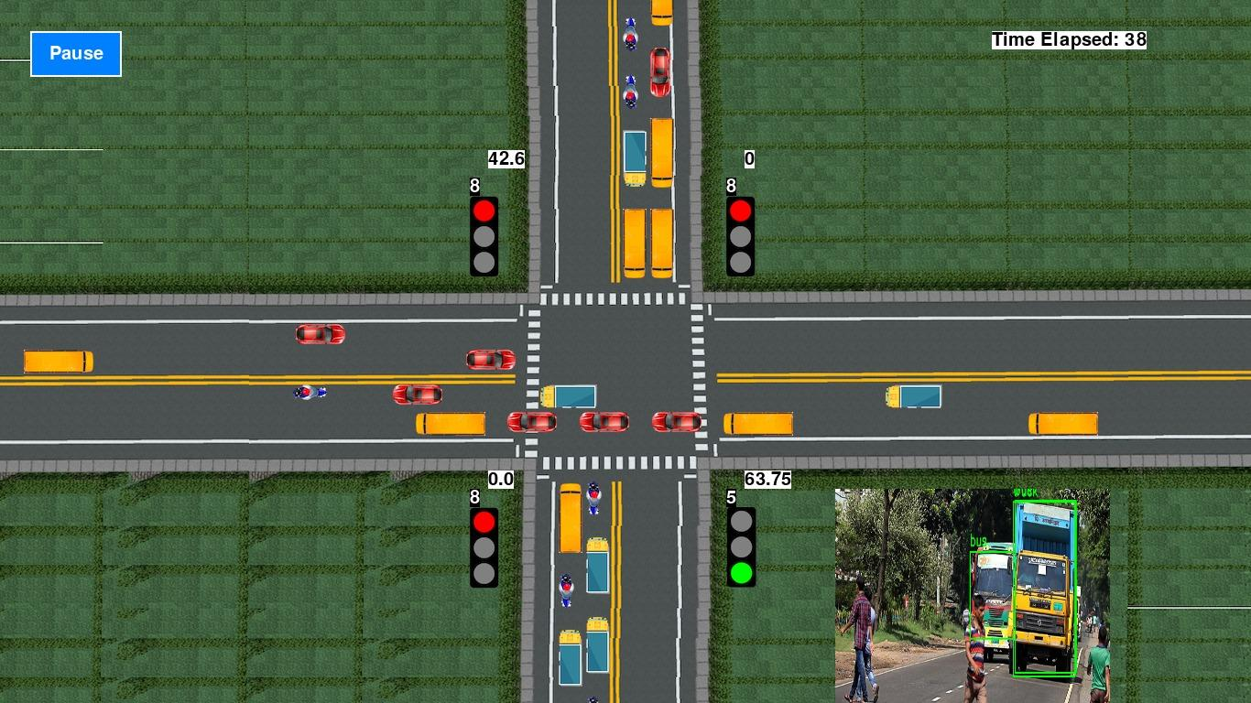
MODULE WORKING

Slide 13
Software / Hardware used
  SOFTWARE REQUIREMENT
    Windows 11
    Google Colab/Jupyter Notebook
  HARDWARE REQUIREMENT
    Processor: Minimum 1 GHz
    Memory (RAM): 4 GB
    Hard Drive: 32 GB
    Internet Connection

Slide 14
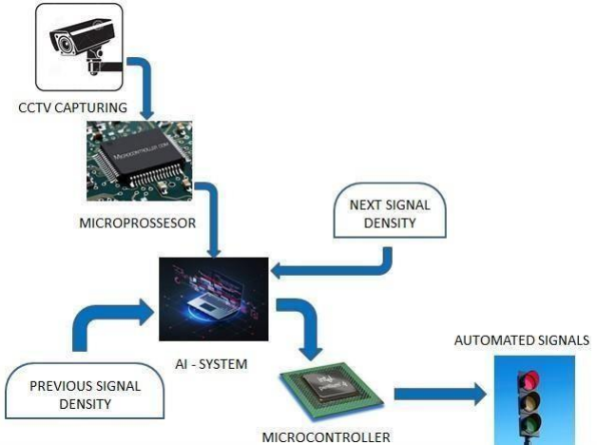
Architecture / Methodology used

Slide 15
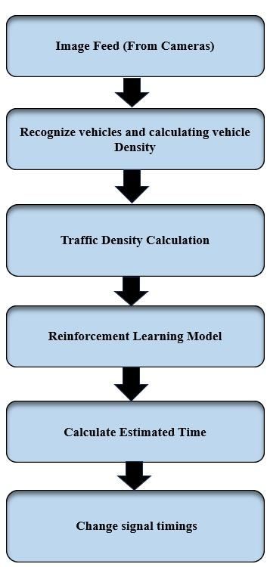
System Design - Flow Chart

Slide 16
Module Description-Vehicle Detection
The first step in this system is to prepare a dataset of images or video footage that includes different types of vehicles and traffic scenarios.
This dataset will be used to train the vehicle detection model. The data is collected from the Dhaka-AI (A dataset in Kaggle).
All the classes which are determined in our deep learning model is used. Only with the help of the classes and labeling, our model is able to understand, train and validate it.
We are using these type of split up not only to increase the accuracy and also to get the desired output

Slide 17

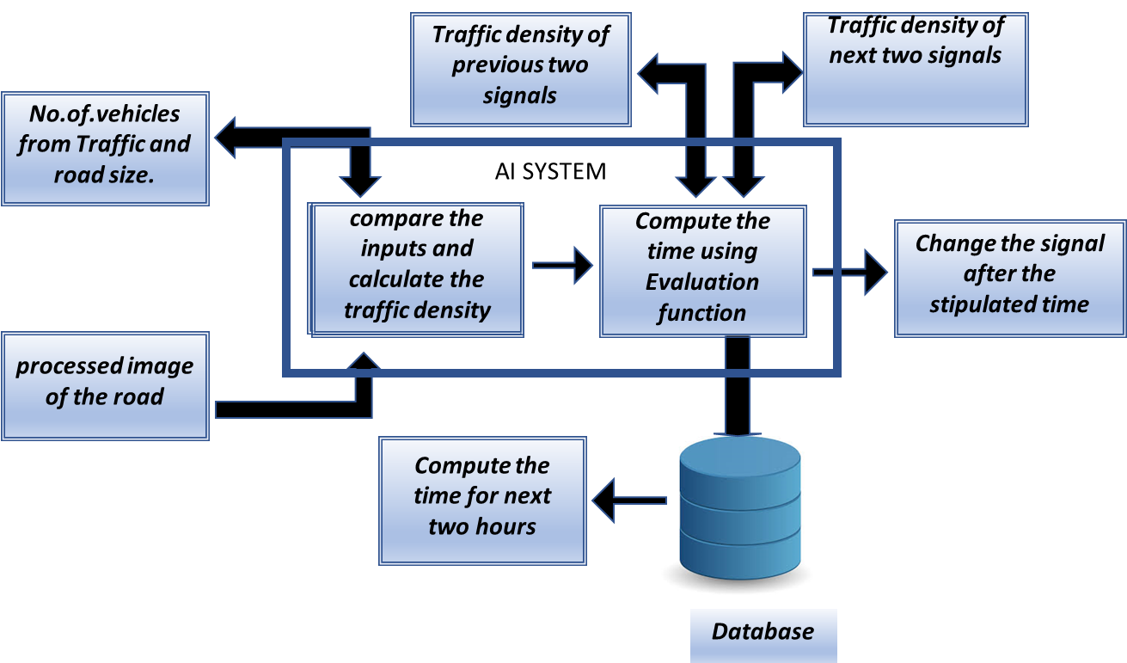

Slide 18
Data preprocessing
The dataset needs to be pre-processed to remove any unwanted noise or artifacts which involve tasks like image resizing, normalization, and filtering.
After pre-processing, the data need to be labeled by manually marking the location of each vehicle in each image or frame of the video footage.
After labeling, Split the labeled dataset into training, validation, and testing sets for model development.
The total data set is split for 2 reasons. One is for training and other one is for validating the trained model.

Slide 19
Model Development and Evaluation
A YOLOv5 model is trained to detect and count the different types of vehicles with the processed data.
The images from dataset are segregated into batches (total of 16 batches) where each batch contain equal no of images. The batches are read by the model again and again with the help EPOCHS. The epochs are increased to get more accurate outputs.
Once the model is fit with train, epochs, validation data and callbacks it is made to run to calculate seconds per step, loss, accuracy loss, validation loss.
At the last epoch the final accuracy is predicted.
The dataset which are plotted with the help of AI plots to label are in xml format. The format are changed to text format and the boundary marks for the labeling is given in each of the text files.

Slide 20
Density Calculation
After the YOLOv5 model has detected the vehicles in an image or video frame, the next step is to calculate the vehicle density.
This is typically done by using formulas that take into account the number of vehicles detected in the particular lane.
The vehicles in these classes are Light-duty vehicles, Medium-duty vehicles and Heavy-duty vehicles.
Traffic Density (D) = ∑ (Number of Vehicles * Congestion factor / Average Vehicle Speed) ÷ Road Capacity

Slide 21
Estimating Signal Time
The final step is to estimate the signal time, which is the length of time that a traffic signal should remain green in order to allow vehicles to pass through the intersection efficiently.
The traffic flow rate is the number of vehicles passing through the intersection per unit time.
The signal time is typically estimated based on the vehicle density and the traffic flow rate.

Slide 22
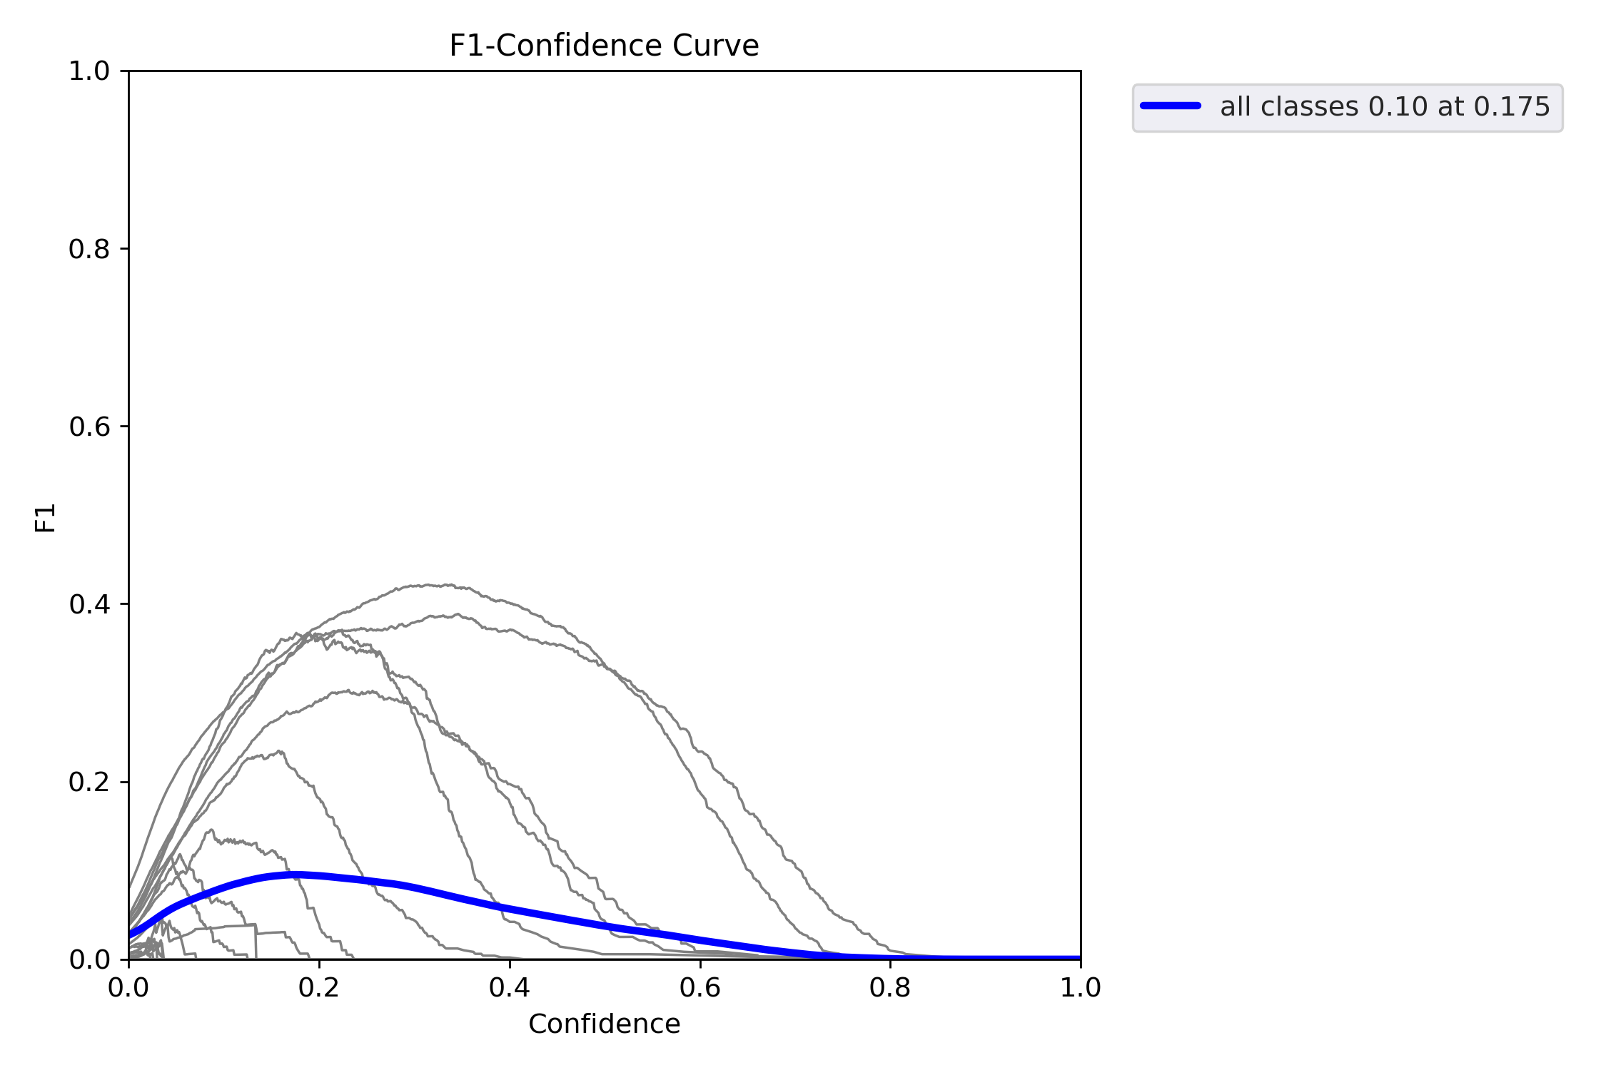
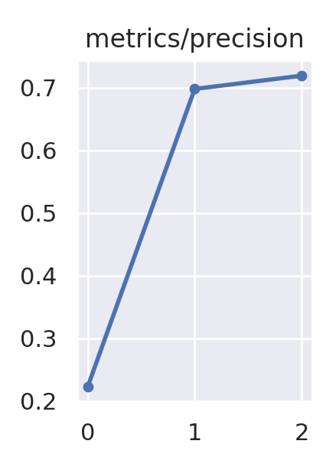
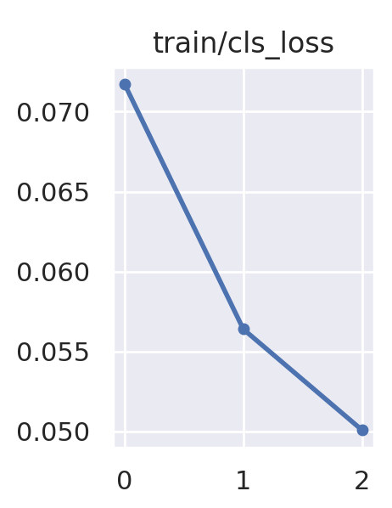
Testing /Performance Evaluation / Results

Slide 23
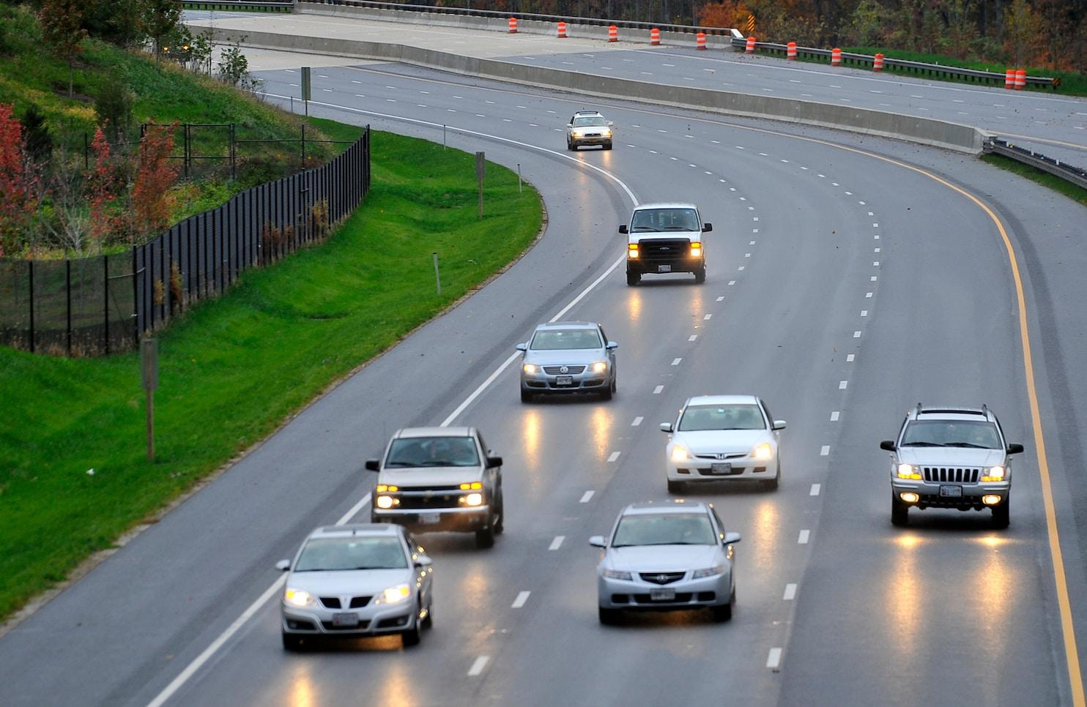
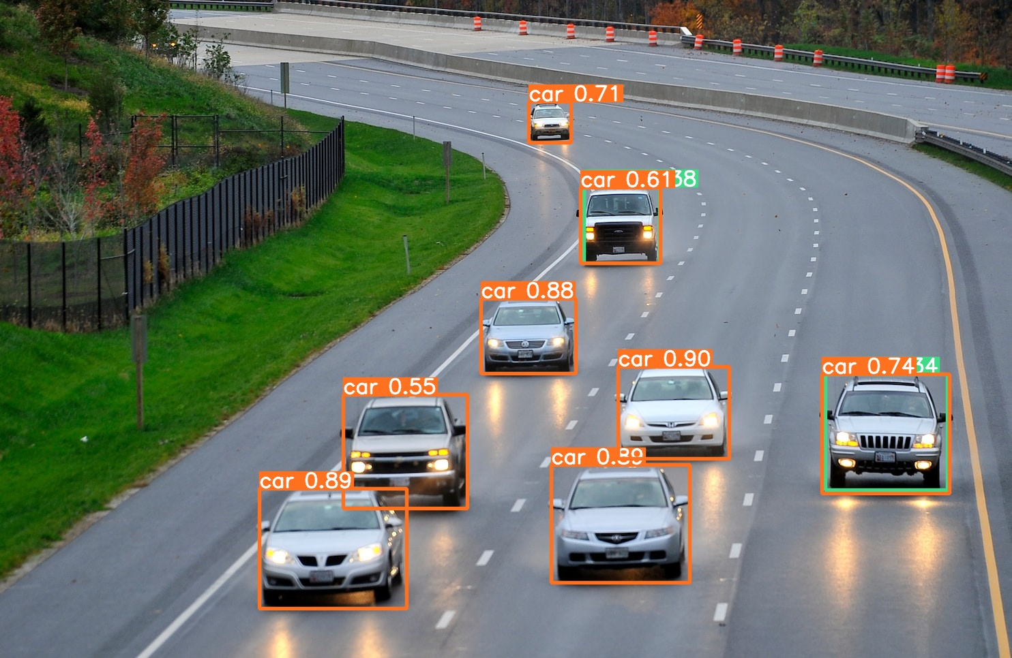
Testing /Performance Evaluation / Results

Slide 24
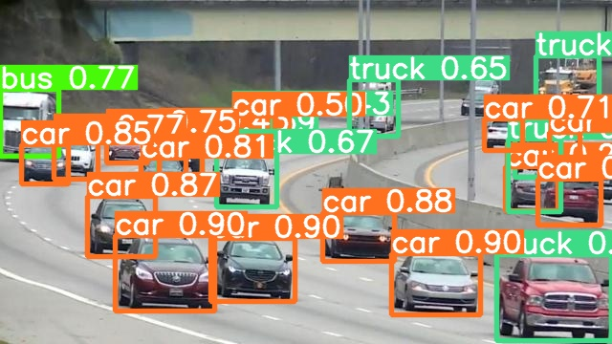
Screen Shots

Slide 25
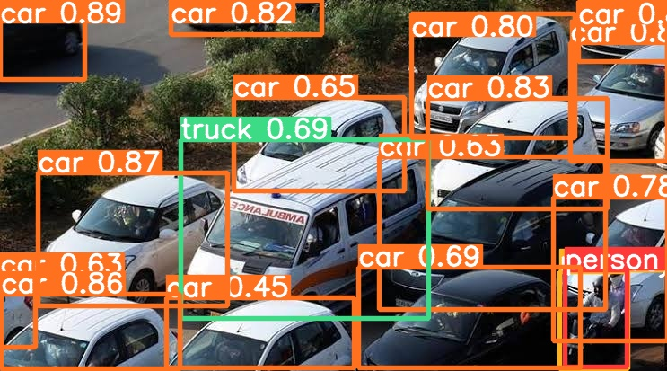
Screen Shots

Slide 26
Screen Shots

Slide 27
Conclusion / Feature Enhancement
This model reduces the traffic drastically which can replaced for the conventional way of traffic movement.
The main objective of developing this system is to minimize the waiting time on the road by optimizing traffic flow when there is no traffic on the other side.
Moreover the system also reduces assignment volume. In addition, the system addresses various traffic violations such as unauthorized parking, motorbike riders without helmets, rerouting, and providing a clear passageway for emergency vehicles by utilizing the technique of image classification

